Slide 1
From tables to collections: Our Journey from SQL to MongoDB

Slide 2

Alex Petrachenka
Software Engineer
A.Petrachenka@ventionteams.com
Full-stack .NET software engineer
4+ years of field experience
3.5 years on a single FinTech project
MongoDB amateur
Notes:
Hello everyone, For those who don’t know me, my name is Alex Petrachenka. I’ve been working for almost 4 years from now on, and the fact is, all that time I was working on a single FinTech project
And the reason you see me today is that I was very lucky to get into the team of high-skilled software engineers, and all together we had a great chance to migrate one legacy application to MongoDB. For me, that was a very exciting experience, and today I’m thrilled to share my story with you.

Slide 3
Meeting plan
01
What we had before. A story of one nasty SQL database
02
How we came to the Mongo,
03
Our path of migration, and what features have we used
04
How MongoDB let us to create a highly available, yet reliable financial app
Notes:
Plan:
What we had before. A story of one nasty SQL database
How we chose the MongoDB
Our first steps in MongoDB and what we’ve found about it
How MongoDB let us to create a highly available, yet reliable financial app

Slide 4
Chapter 1 - It all began with the SQL
Notes:
So, our story began its existence with one nasty SQL database. The story of the existing SQL database lasted since the very 2007, and by the moment the Vention team (and me ofc) got acquainted with it, its structure was terrifying.

Slide 5
Our project so far:
01
Multitenant application — tenants are added through time, and each tenant database has specific requests, still, single app deployment needs to handle it
02
Largest data sets — around a few million, not that impressive, it wasn’t some big data project, but still…
03
Datasets are under constant recalculations, each update may trigger the recalculation of a significant set of entities. That means we needed to effectively search the data and minimize recalculated data as much as we could.
Notes:
But the case, we are interested in, began its existence with one nasty SQL database. The story of the existing SQL database lasted since the very 2007, and by the moment the Vention team (and me ofc) got acquainted with it, its structure was terrifying.
Here are a couple of details about the project to get the big idea:
Multitenant application — tenants are added through time, and each tenant database has specific requests, still single app deployment needs to handle it
Largest data sets — around a few million, not that impressive, it wasn’t a big data
Datasets are under constant recalculations, each update may trigger the recalculation of a significant set of entities. That means we needed to effectively search the data and minimize recalculated data as much as we could.

Slide 6
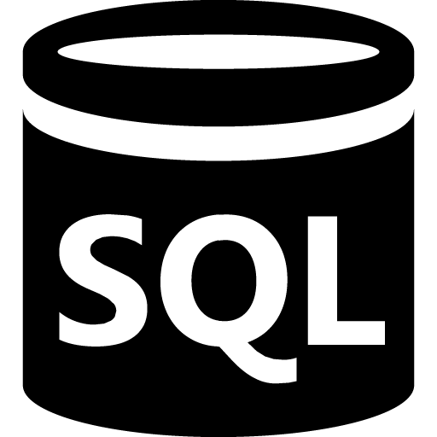
A few words about SQL
Exists for 50 years
SQL databases hold the dominant position in the database market
Hard to maintain and architect
Notes:
So, for those of you, who were already working with SQL, you may know 2 things for sure:
SQL databases are great. No, really. It is hard to imagine something so widely spread and popular. And I can barely imagine, how much solutions were built on top of SQL. In fact, the story of SQL has lasted for more than 50 years now, that’s quite impressive.
To get the most out of your SQL database, you have to put some serious effort into architecting your data schema. You have to plan, to maintain, to make sure you’re following the database normalization forms and best practices. And if you do, most likely you get something as beautiful and simple as that:

Slide 7

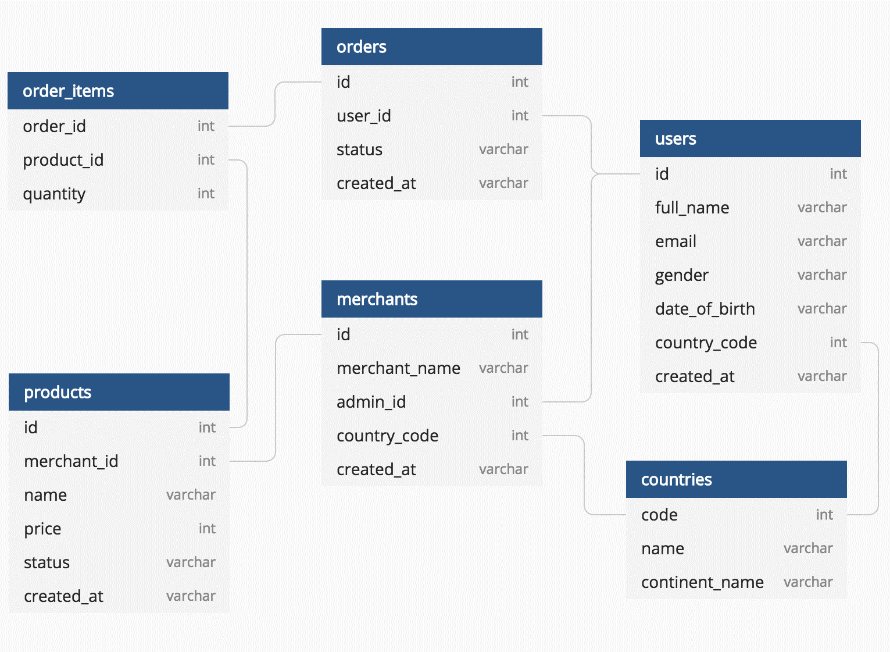
It’s okay
Notes:
So, on this schema, we have an example of how a well-architected database would look like, The idea is simple and elegant, the tables are effective, and as a software engineer I could easily figure out how to get the data I need

Slide 8
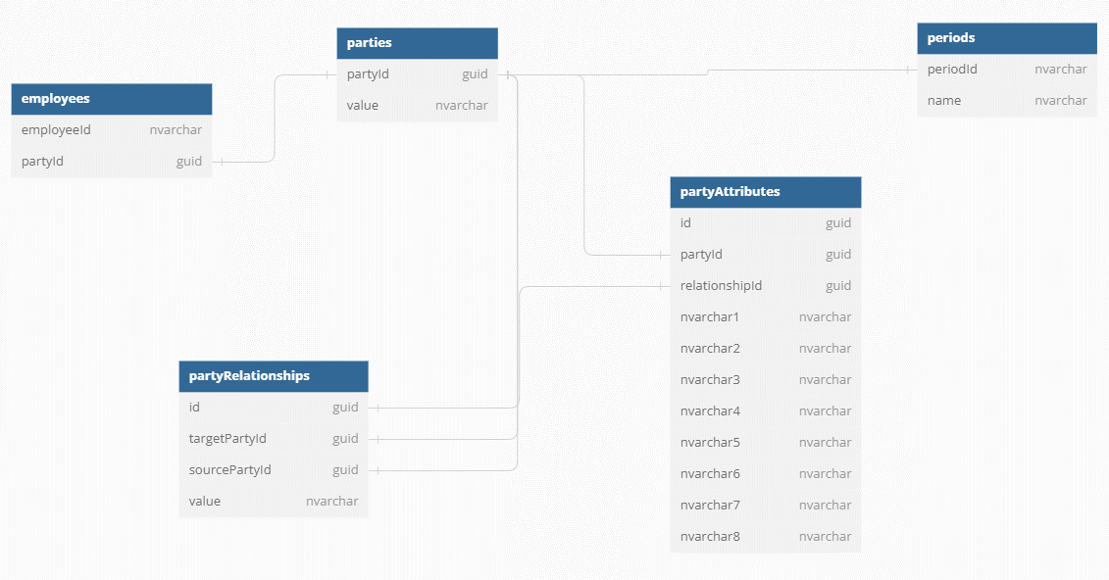

Notes:
But in the real world, we most likely have something like this. This is a harsh example of how our data was stored. Now, if you try to compare that database structure with, for example, Northwind, or some well-structured and built database, maybe the first thing you’ll see, there are some tables, called party-something. And from the semantical perspective, you may wonder, what the hell does that mean? At that moment, I was like “Okay, I do understand what the accounting period is, what the employees, users, roles, and demographics tables are. But how do they relate to each other? How do I get employee records in terms of one accounting period?”
Later we figured out

Slide 9
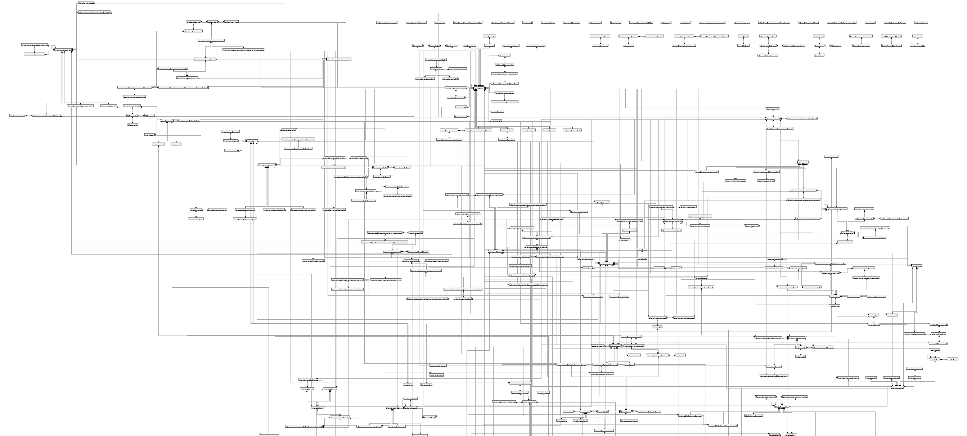


Slide 10
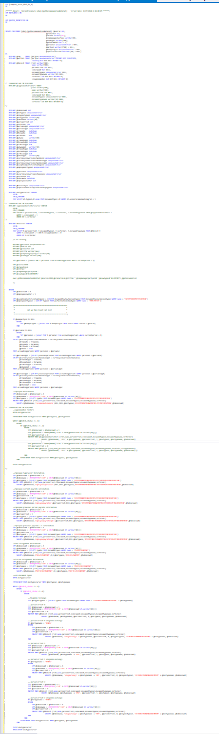
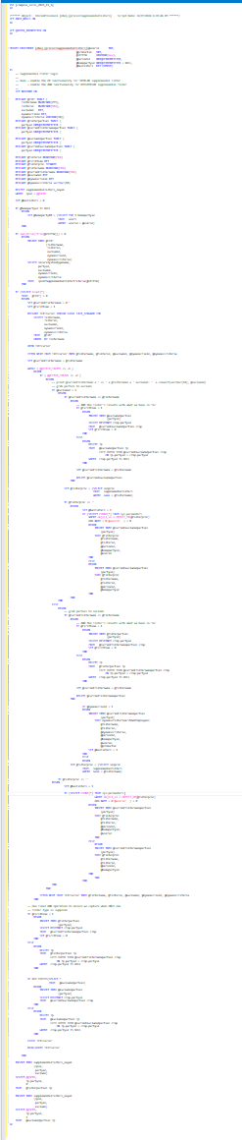
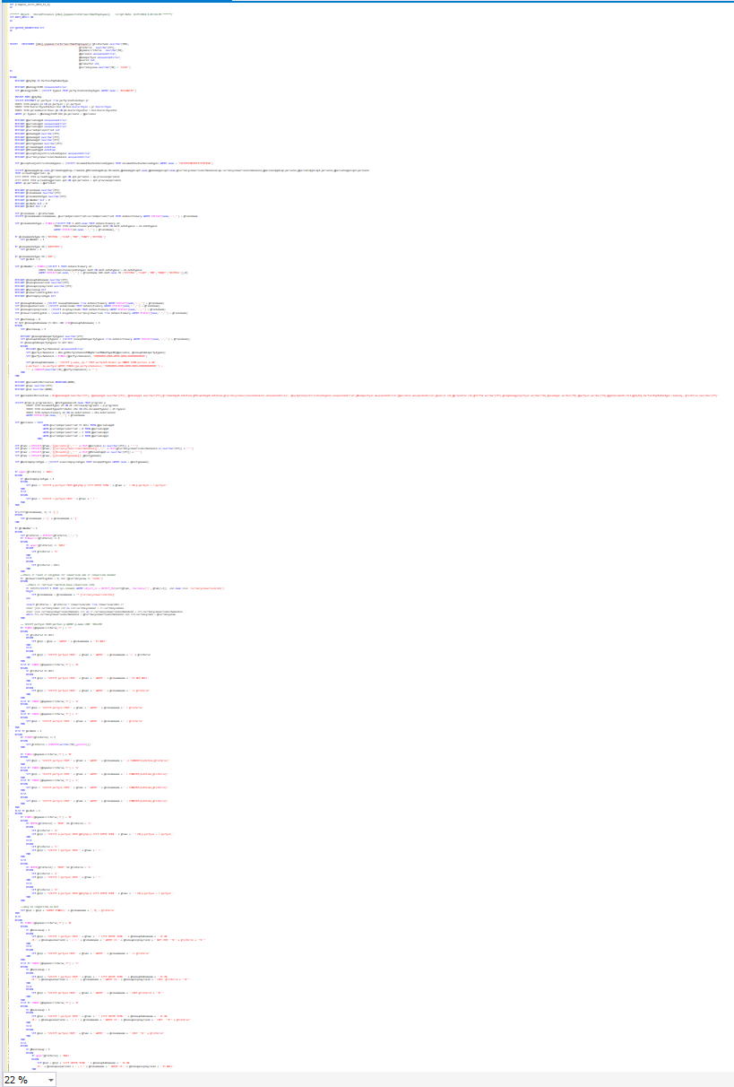
1000+ lines
300+ lines
300+ lines + dsql

Slide 11

Some common problems we’ve faced
01
Investigation time and entry threshold (there were 500+ tables, and 2000+ SPs)
02
How do we effectively get the data we need? How do we add something new?
03
Scalability and performance – how do we scale the database for new tenants
Notes:
Now you can imagine some common issues with that kind of database
Investigation time — I’d put that thing on top of everything because no matter what you’re going to do with that database, first of all, you need to do plenty of investigation and figure out, how you gonna do that. Are you fixing a bug? — most likely you’re gonna spend some serious time querying that database, finding relations, and understanding, why have you lost some employees in the accounting period.
How do you get this data? The other pitfall is you can’t simply query the data from the database. through the backend and get to a UI. So as you’re trying to get some data from the database and show it on your application, most likely you’re going to find yourself writing Stored Procedures. And we all know what is like to debug a stored procedure
Scalability and performance. Now, as you may know, the SQL database itself is quite fast. You may get millions of records in under a few seconds if your schema is well-architected. But well architecture wasn’t the case. Due to the high customization of tenant applications, one of the requirements of the database structure was to keep it as flexible as possible. That means if you need to add a new entity, you need some abstract way to describe it. That causes many-to-many relations, redundant joins, and a ton of unnecessary logic just to get a few records.
As we were trying to find a way to solve all the above, we thought, what if we try to step away from SQL and try something else? Since we already had a requirement to support a dynamic data structure, it looked a lot like we would fit into something like MongoDB or CosmosDB. So we decided to give it a shot and make a POC.

Slide 12
So, what are the options?
JSON {}
To put it inside of SQL database?
Use No-SQL, document-oriented
CosmosDB
MongoDB

Slide 13

Chapter 2 - MongoDB

Slide 14
Aspect | SQL (Relational Databases) | MongoDB
Data Model | Structured (Tables) | Flexible (Json-like documents)
Scalability | Vertical scaling (additional hardware resources) | Horizontal scaling (distributed across multiple servers)
Query Language | SQL | MongoDB query lang + Aggregation Framework
Schema Flexibility | Rigid schema, requires alterations for schema changes | Flexible schema, supports unstructured and evolving data
Transactions | ACID-compliant (strong transactional support) | BASE
Use Cases | Complex querying, structured data, transactions | Unstructured data, high scalability, real-time analytics

Slide 15
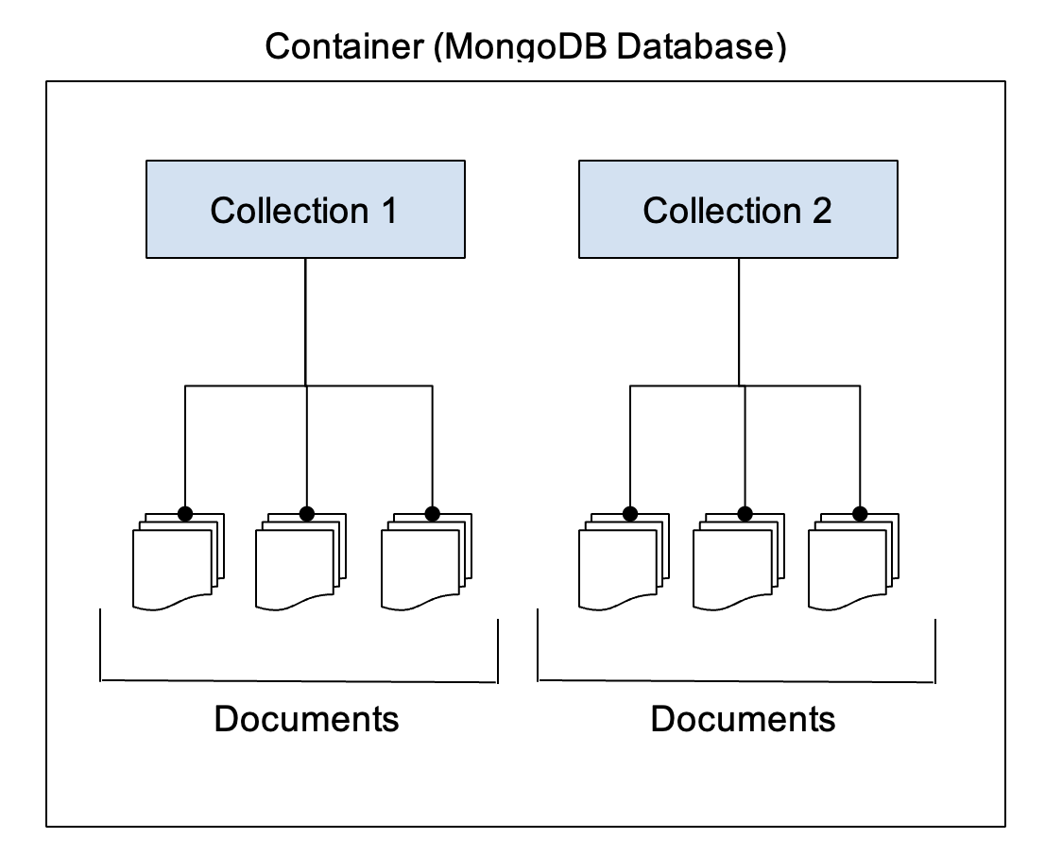
Inside of MongoDB
Notes:
So for those who don’t know anything about Mongo, these are a few key notes to understand, what’s going on inside of it:
MongoDB is a document-oriented database. Apart from SQL, which describes how data should be stored in terms of tables and columns, MongoDB stores your data in BSON - Binary JSON
Inside the database, MongoDB stores documents in collections. A Collection is often considered a set of documents with a similar structure. Although, Mongo doesn’t have any restrictions on that.
Each document has a restriction of 16MB. Usually, it is quite a lot, but you may consider it when developing your document schemas.

Slide 16
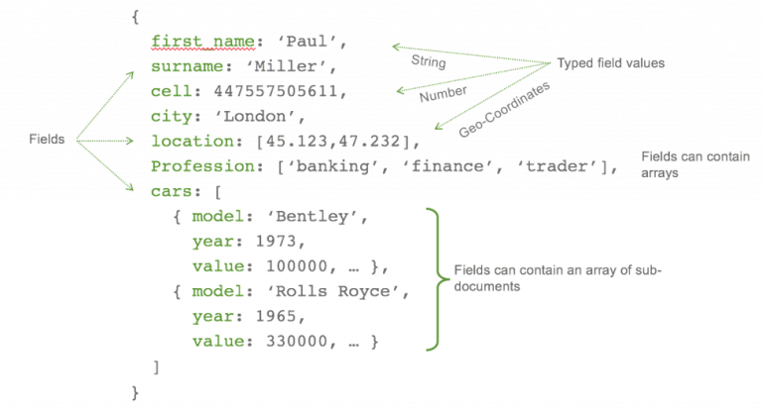
Flexible schema
Notes:
But what attracts us to MongoDB, there are 2 key concepts, we found quite useful;
We have a flexible schema. So, Mongo doesn’t require you to have some kind of strict pre-defined schema in your database, as SQL does. With that, we felt real freedom in developing a flexible application and working with dynamic data structures.

Slide 17
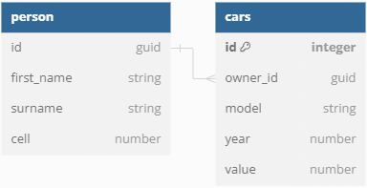
Nesting
Notes:
There is a completely different approach to keeping related data. With MongoDB, you can keep related data right in your host document. Simple as that. No more joins are required, and you can be flexible with designing your data storage from the needs of your application.

Slide 18
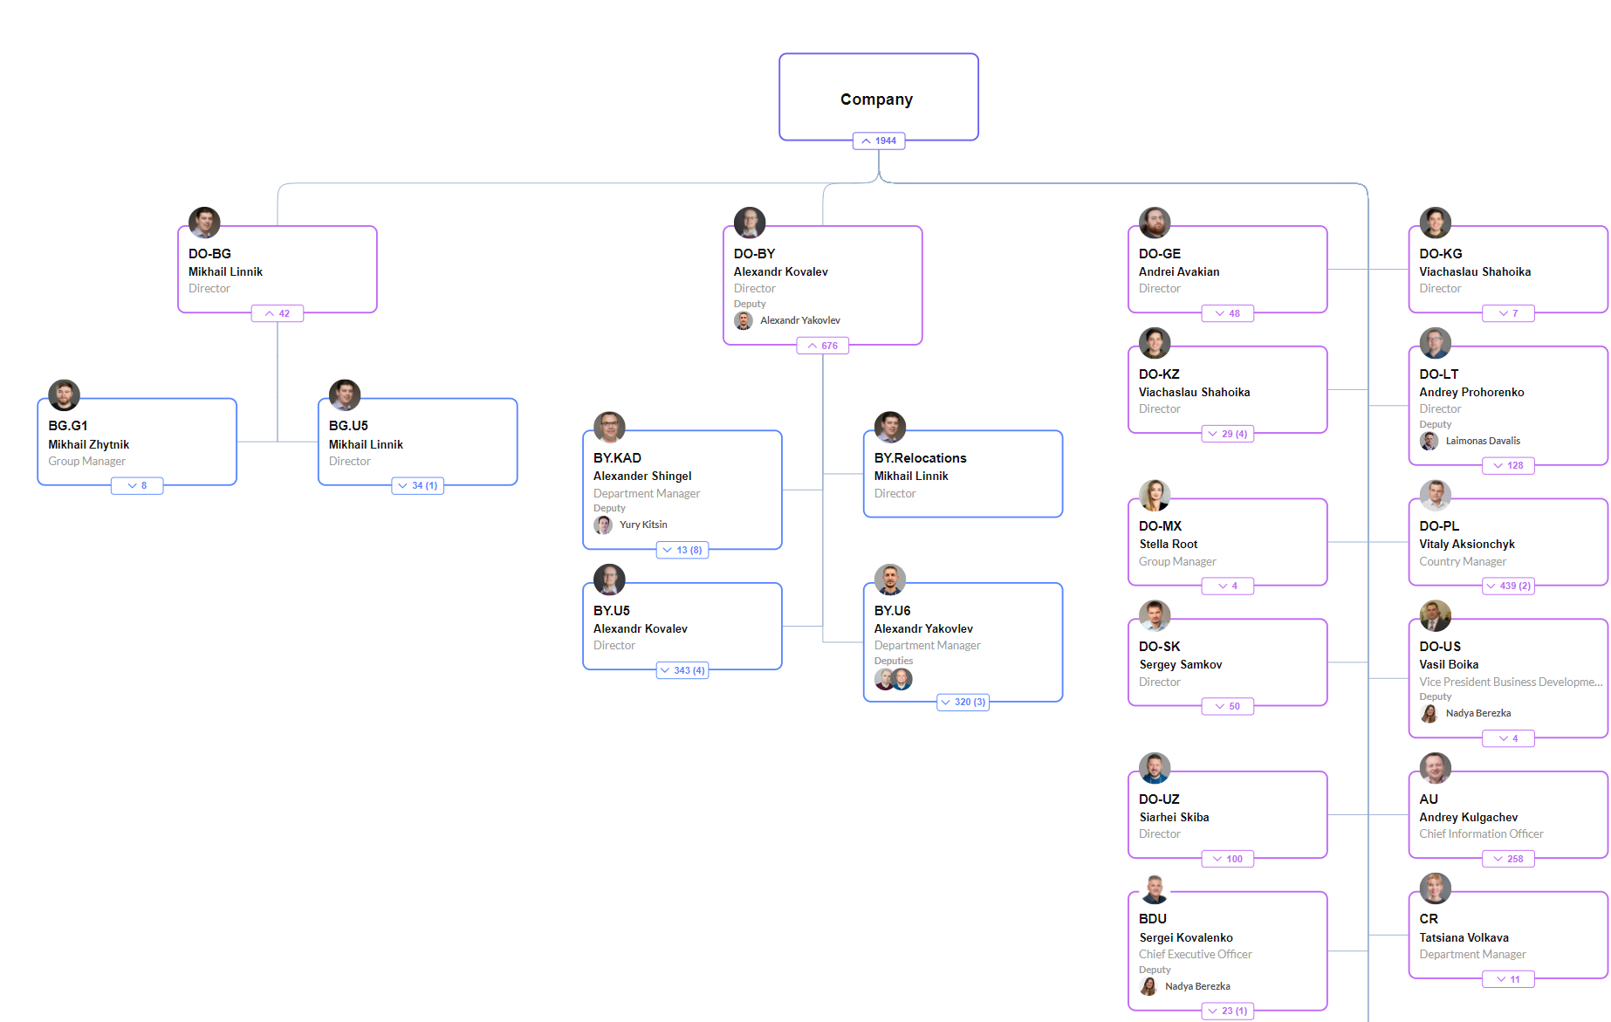
Hierarchy problems
Notes:
Hierarchical problems — Because of a flexible document structure it is much easier to store hierarchy trees in the database. And that was a thing in the HRM system. Previously in SQL, it took us either writing a ton of SQL code with some limitations in a degree of nesting or recursively calling SQL again and again and again… In Mongo, we can store the tree as it is and then just pick it up.

Slide 19
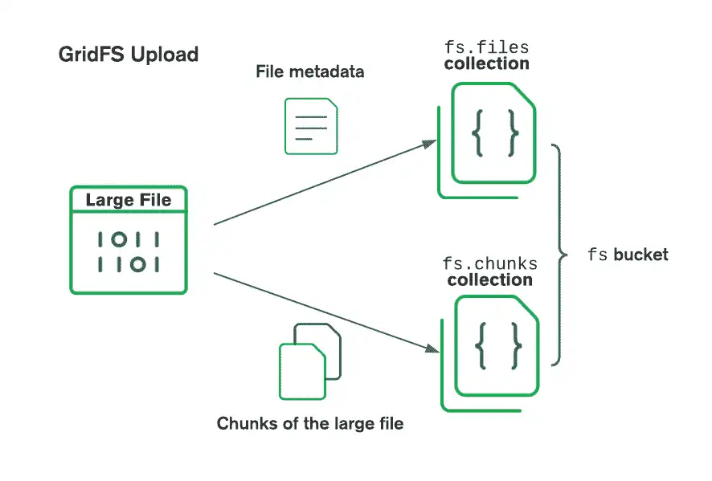
Grid FS
Notes:
Another useful feature of MongoDB we found out about is the GridFS. So, as Mongo stores your data in binary format, technically it became possible and quite convenient to keep some kinds of files right inside the database. Simple as that, mongo takes your file, breaks it byte array into chunks, and saves it along with a header, that helps you to retrieve the blob. And of course, that header is customizable, so you can add your custom metadata and simplify future searches.

Slide 20

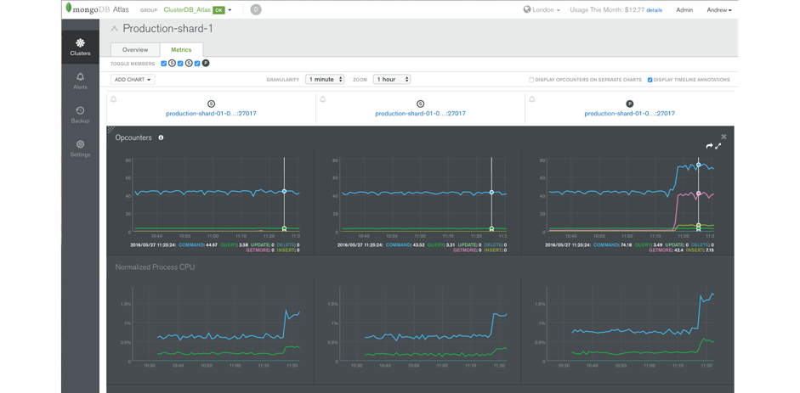
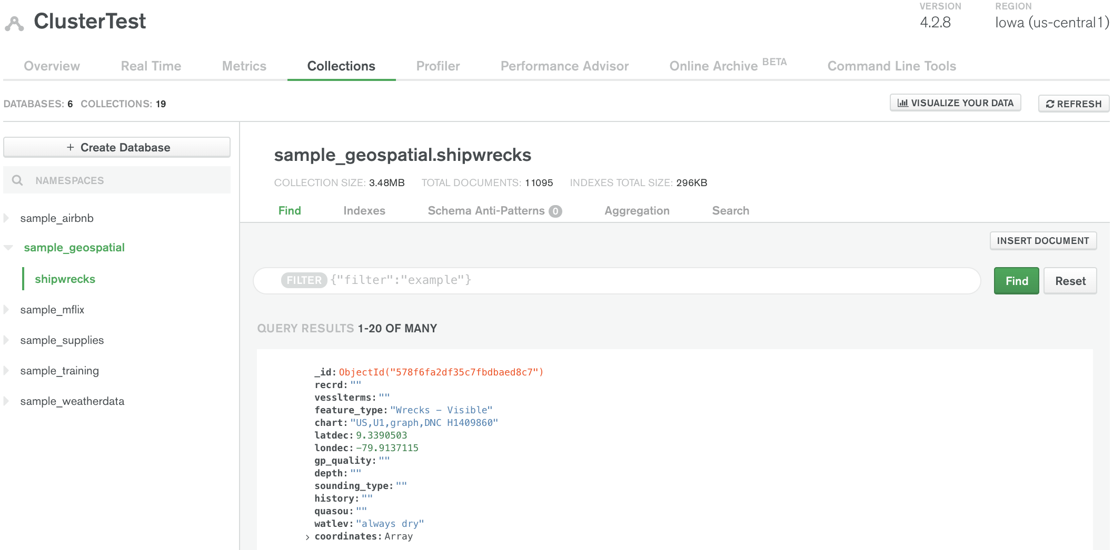
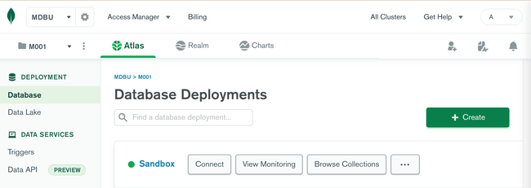
Notes:
MongoDB Atlas offers several benefits, including fully managed database services that handle complex operational tasks like backups, scaling, and monitoring, allowing developers to focus on building applications. It provides high availability with automated failover, security features like encryption and access controls, and seamless integration with various cloud providers. Atlas supports multi-region deployments for global applications, automated performance optimization, and real-time analytics. Additionally, it offers a flexible, pay-as-you-go pricing model, ensuring cost efficiency and scalability to meet varying workloads and business needs.

Slide 21
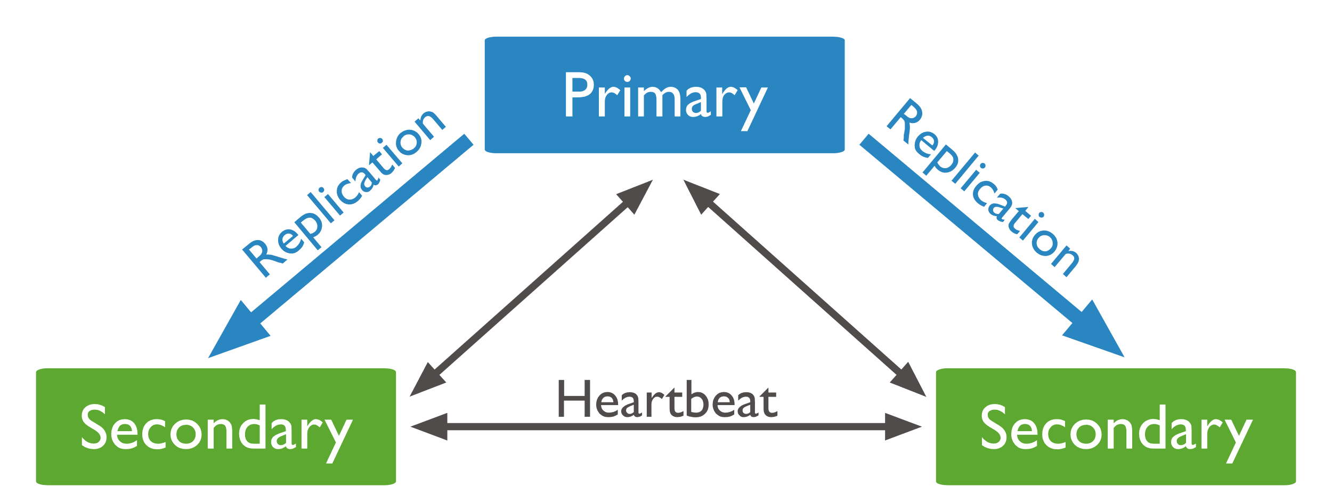
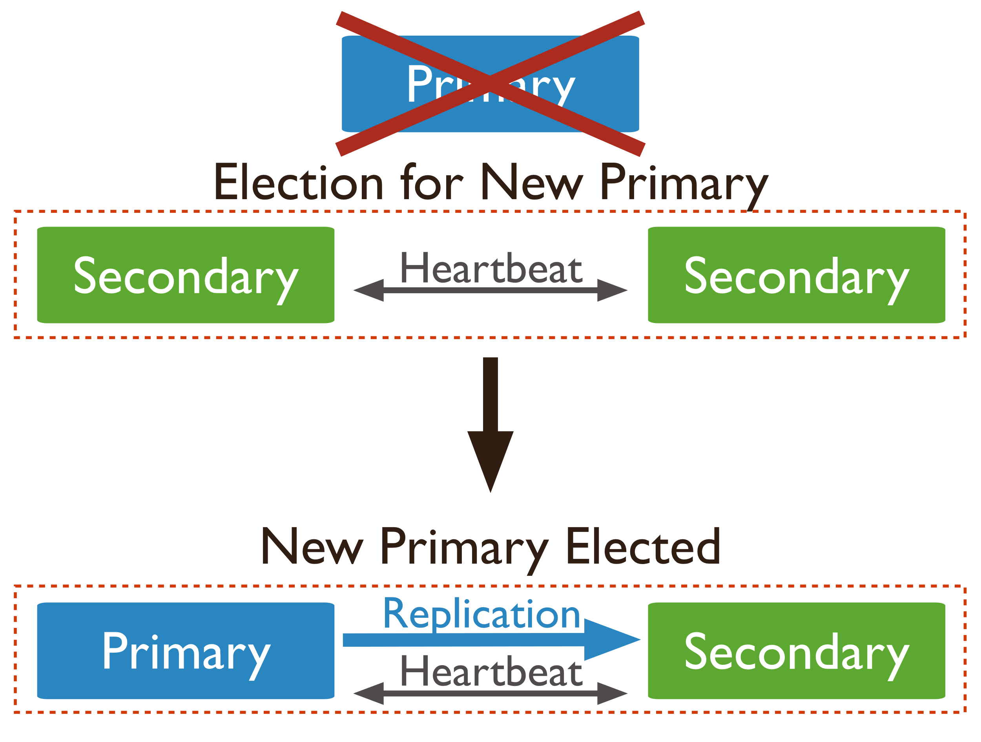
Replication
Notes:
Replication — Mongo allows you to deploy a set of DB instances and use this technique to scale your database horizontally. What’s probably the best part of the replica set, it is self-managed, so MongoDB elects your primary node in case of primary instance failure.

Slide 22
& More…
TTL Indexes
Change Streams
Sharding

Slide 23
Chapter 3 – Is Mongo good?

Slide 24
ACID vs BASE
Atomicity Consistency Isolation Durability
Basically available
Soft state
Eventual consistency

Slide 25

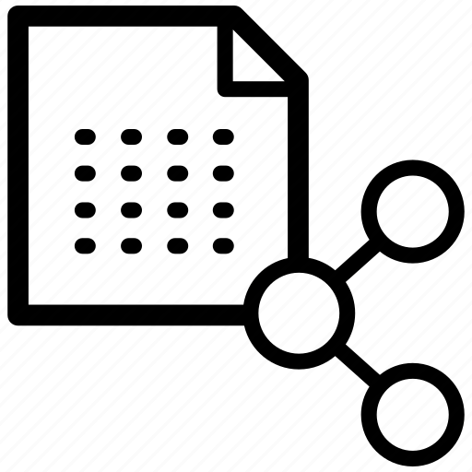


How Mongo handles reliability
Replication
Durability with Journaling
Consistency
Monitoring and Maintenance
Notes:
But while MongoDB follows the BASE principles to achieve high availability and scalability, it incorporates several features to ensure reliability:
Replication: Data redundancy and automatic failover through replica sets.
Durability: Journaling and transaction support to ensure data persistence.
Consistency: Flexible read concerns and eventual consistency mechanisms to balance performance and reliability.
Monitoring and Maintenance: Tools and services for monitoring, backup, and automated maintenance.

Slide 26

А blot on the landscape...
Some issues we’ve faced on the way:
Resource usage and costs — in order to get the most out of the performance, MongoDB gets everything it has. On Atlas, it is pretty hard to find the balance between cost optimization and optimal cluster tire. On low tires like M10, MongoDB can be very slow sometimes. Slow, but yet useful
Write Conflicts: High write loads can lead to conflicts and performance degradation.
Backup Strategies: Ensuring consistent and reliable backups requires careful planning, especially for large datasets. And it is also tailed with high costs. In the end, we had to create our custom backup tools for the largest dataset.
GridFS and its performance. It turned out to be very good for small files, like user avatars, but for something larger, it could be slow

Slide 27
Chapter 4 – Conclusion

Slide 28
Some migration results:
01
We have resolved our issues with dynamic data schemas
02
As the project grows, we have a solid base for database scaling. We can scale out horizontally by adding new replica nodes
03
For performance purposes and additional scaling, we still can use sharding
Notes:
We have resolved our issues with dynamic data schemas. The flexible schema of MongoDB allows us to effortlessly develop new features and fulfill clients’ requests. We no longer have any business logic on the database level, and that simplifies the development process.
As the project grows, we have a solid base for database scaling. We can scale out horizontally by adding new replica nodes
For performance purposes and additional scaling, we still can use sharding

Slide 29
To be continued…

